Slide 1
Software Maintainability Prediction Using Ensemble Learning
UROP PROJECT
Mentor: Dr. Ramachandra Reddy
Masana Dhathri Praveenya -AP19110010217
Nandamuri Laasya Choudary -AP19110010248
Chebium Sai Pranay -AP19110010255
JayaBharath Mothukuri -AP19110010264

Slide 2
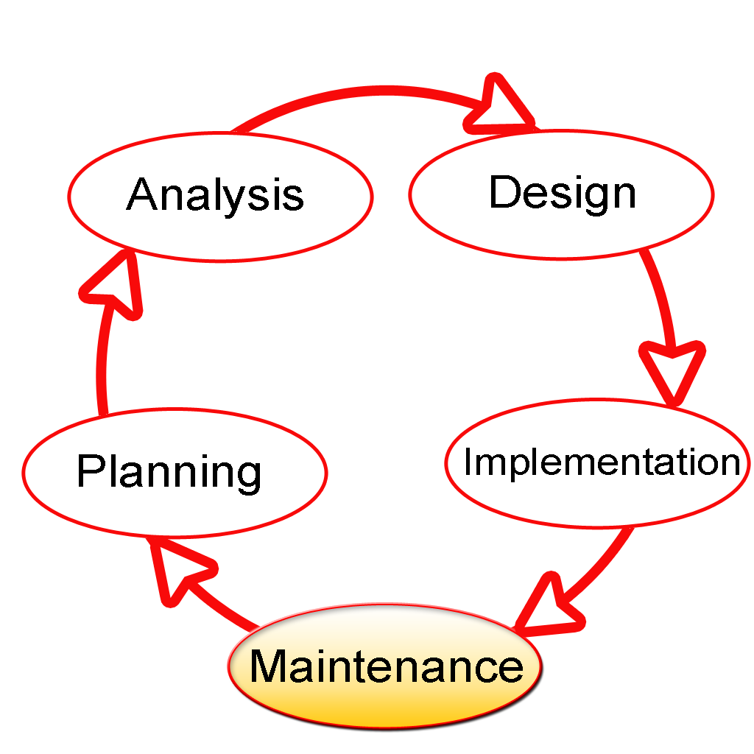
Stages of Software Development
A software project lifecycle consists of five different phases. They are planning, designing, development, testing, deployment and maintenance.
The software project maintenance is the longest phase of a project life cycle and is the most costly phase as well. Maintenance of software requires a lot of effort.

Slide 3
What is Software Maintenance?
Once the software is developed and delivered, maintenance plays an important role in the success of the software.
The prediction of the effort required for software maintainability would result in effective management.
Many companies invest almost 60% of their project cost into maintenance.
Maintenance also plays an important role to keep up with emerging technologies and products over time.

Slide 4
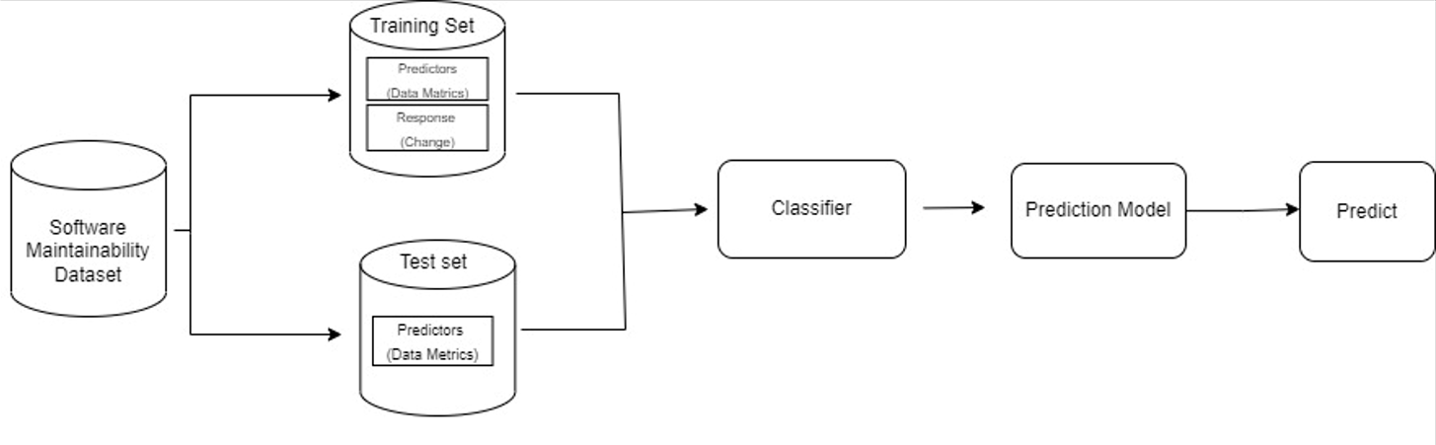
Proposed Method
In this research, using ensemble methods and Machine Learning (regression) methods we predicted software maintainability.
The objective of this research is to investigate and evaluate different ensemble methods and to compare them against individual models and also among themselves.

Slide 5
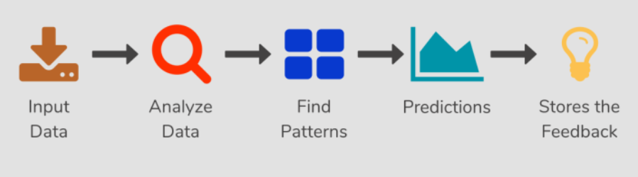
What is Machine Learning?
Machine learning (ML) is the study of computer algorithms that can improve automatically through experience and by the use of data. It is seen as a part of artificial intelligence.
Machine learning algorithms build a model based on sample data, known as training data, in order to make predictions or decisions without being explicitly programmed to do so.
Machine learning algorithms are used in a wide variety of applications, such as in medicine, email filtering, speech recognition, and computer vision, where it is difficult or unfeasible to develop conventional algorithms to perform the needed tasks.

Slide 6
Types of Machine Learning Algorithms
For this software maintenance, we’ll be checking the accuracy based on applying different machine learning algorithms. Some of them are:
Linear regression
Support Vector regression (SVR)
Artificial Neural Networks (ANN)

Slide 7
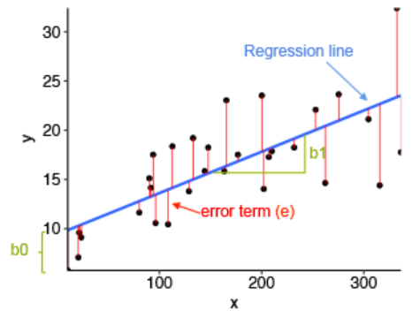
Linear regression
Linear regression is one of the easiest and most popular Machine Learning algorithms. It is a statistical method that is used for predictive analysis.
Linear Regression is the supervised Machine Learning model in which the model finds the best fit linear line between the independent and dependent variable.

Slide 8

Support Vector Regression (SVR)
Support Vector Regression is a supervised learning algorithm that is used to predict discrete values.
Support Vector Regression uses the same principle as the SVMs.
The basic idea behind SVR is to find the best fit line. In SVR, the best fit line is the hyperplane that has the maximum number of points.

Slide 9
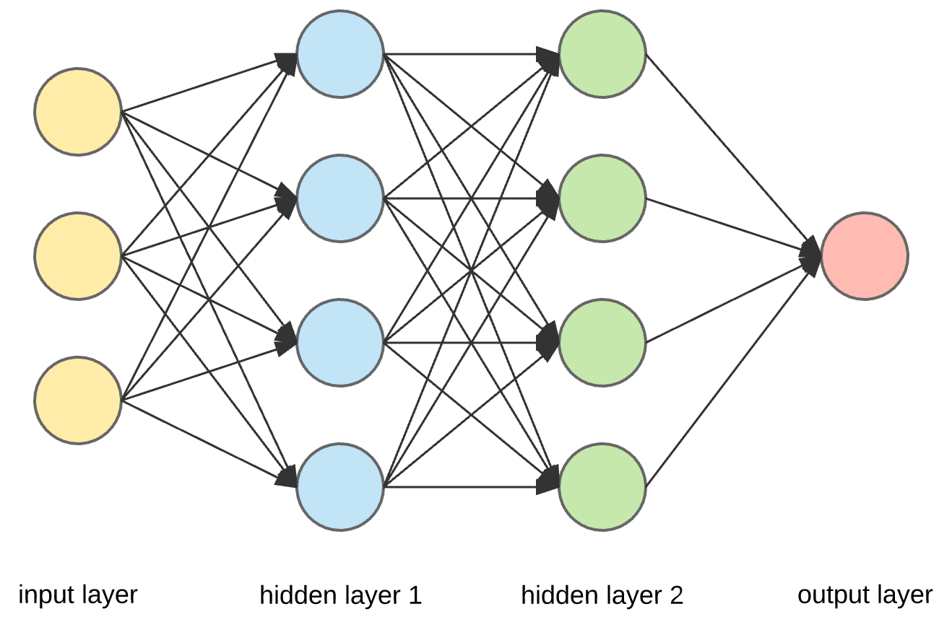
Artificial Neural Network (ANN)
An artificial neuron network (neural network) is a computational model that mimics the way nerve cells work in the human brain.
Artificial neural networks (ANNs) use learning algorithms that can independently make adjustments - or learn, in a sense - as they receive new input.
It has the ability to learn and model non-linear and complex relationships as many relationships between input and output are non-linear.

Slide 10
Ensemble Technique
An ensemble of computational intelligence models uses the outputs of all its individual constituent prediction models, each being assigned a certain priority level, and provides the final output with the help of an arbitrator.
There are single-model ensembles and multi-model ensembles. In single-model ensembles, the individual constituent prediction models are of the same type, but each with a randomly generated training set.
Examples of single-model ensembles include Bagging and Boosting . In multimodel ensembles, there are different individual constituent prediction models.

Slide 11
Types of Ensemble Methods
For this software maintenance, we’ll be checking the accuracy based on applying different single model boosting ensemble methods. Some of them are:
AdaBoost Classifier
Gradient Boost Regression
XGBoost Regression
CatBoost Regression

Slide 12
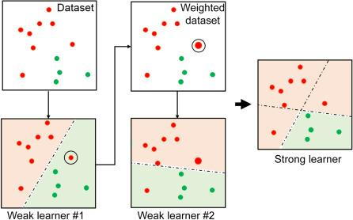
AdaBoost Classifier
AdaBoost implements boosting, wherein a set of weak classifiers is connected in series such that each weak classifier tries to improve the classification of samples that were misclassified by the previous weak classifier.
In doing so, boosting combines weak classifiers in series to create a strong classifier.
AdaBoost is slower to train.

Slide 13
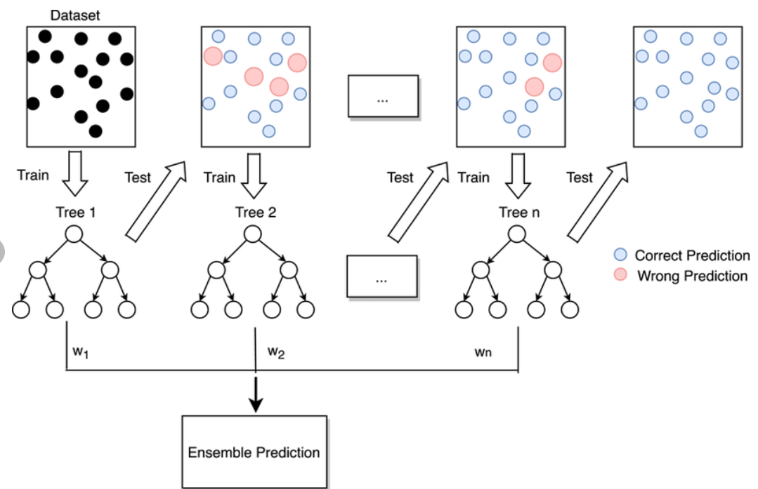
Gradient Boost Regression
Gradient boosting is a machine learning technique for regression and classification problems that produce a prediction model in the form of an ensemble of weak prediction models.
This technique builds a model in a stage-wise fashion and generalizes the model by allowing optimization of an arbitrary differentiable loss function.
Gradient boosting basically combines weak learners into a single strong learner in an iterative fashion.
As each weak learner is added, a new model is fitted to provide a more accurate estimate of the response variable.

Slide 14
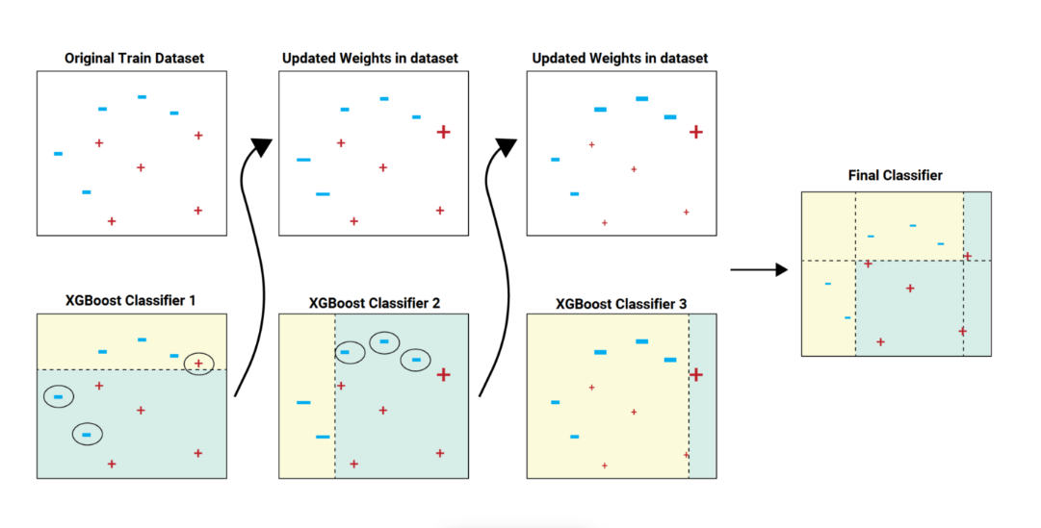
XGBoost Regression
XGBoost is an implementation of Gradient Boosted decision trees. In this algorithm, decision trees are created in sequential form .
Weights play an important role in XGBoost. Weights are assigned to all the independent variables which are then fed into the decision tree which predicts results.
The weight of variables predicted wrong by the tree is increased and these variables are then fed to the second decision tree.
These individual classifiers /predictors then ensemble to give a strong and more precise mode.

Slide 15
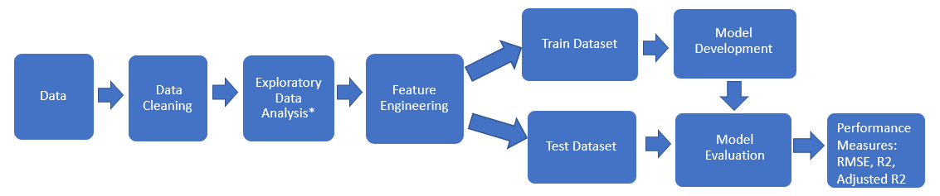
CatBoost Regression
CatBoost builds upon the theory of decision trees and gradient boosting.
The main idea of boosting is to sequentially combine many weak models and thus through greedy search create a strong competitive predictive model. Because gradient boosting fits the decision trees sequentially, the fitted trees will learn from the mistakes of former trees and hence reduce the errors.
This process of adding a new function to existing ones is continued until the selected loss function is no longer minimized.

Slide 16
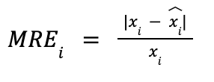
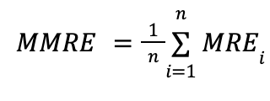

Performance Measures
Mean Relative Error: Relative error is the ratio of the mean absolute error to the mean value of the quantity being measured.
Mean Magnitude Relative Error: It measures the difference between actual and estimated effort relative to the actual effort.
Pred(0.3): is a measure of the percentage of observations whose MRE is less than or equal to 0.3

Slide 17
Dataset Description
For predicting the software maintainability we took use of two famous datasets QUES and UIMS.
We divided our data into two parts. 80% of the data is used for training and 20% of the data is used for testing.
We have considered Machine Learning algorithms and ensemble methods to evaluate Datasets.

Slide 18
Dataset Description
Metric | Description
WMC | Count of methods implemented within a class
DIT | Level for a class within its class hierarchy
NOC | Number of immediate subclasses of a class
RFC | Count of methods implemented within a class plus the number of methods accessible to an object class due to inheritance
LCOM | The average percentage of methods in a class using each data field in the class subtracted from 100%
MPC | The number of messages sent out from a class
DAC | The number of instances of another class declared within a class
NOM | The number of methods in a class
SIZE1 | The number of lines of code excluding comments
SIZE2 | The total count of the number of data attributes and the number of local methods in a class

Slide 19
Result Analysis
The two datasets QUES and UIMS taken into consideration and applied ML and ensemble for predicting Software maintenance.
Table provides the results obtained from applying the individual algorithms on the QUES dataset.
 | MSE | RMSE | Pred(0.3)
Linear Regression | 3770.43 | 61.40 | 0.067
SVR | 829.67 | 28.80 | 0.33
ANN | 2656.86 | 53.73 | 0.33

Slide 20
Result Analysis
Table below provides the results obtained from applying the ensemble methods for the QUES dataset. The ensemble methods we have used in this research are AdaBoost, Gradient Boost, XGBoost and CatBoost regression.
 | MSE | RMSE | MMRE | Pred(0.3)
AdaBoost | 3357.97 | 56.58 | 0.83 | 0.0
Gradient Boost Regression | 1094.27 | 26.01 | 0.70 | 0.47
XGBoost Regression | 3455.06 | 58.63 | 0.87 | 0.07
CatBoost Regression | 2272.27 | 47.67 | 0.60 | 0.27

Slide 21
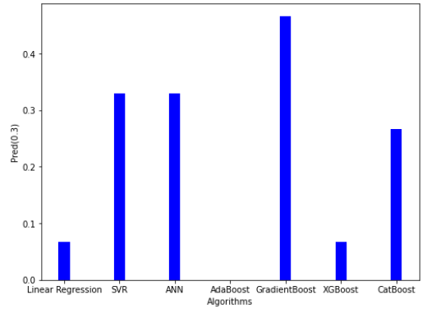
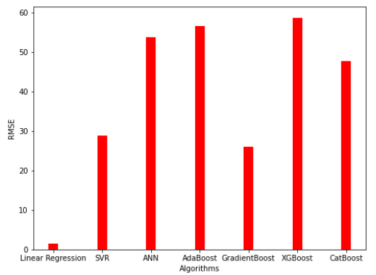
Result Analysis
The following figures shows performance results (Pred(0.3), RMSE)s of QUES Dataset

Slide 22
Result Analysis
Table below provides the results obtained from applying the individual algorithms on the UIMS dataset. The individual algorithms we have taken in table 3 are linear regression, SVR, and ANN. We have calculated the performance measures MRE, RMSE, Pred(0.3). Out of all the models it can be observed that linear regression outperformed all the individual algorithms.
 | MSE | RMSE | Pred(0.3)
Linear Regression | 170.70 | 13.07 | 1.0
SVR | 6731.32 | 82.04 | 0.25
ANN | 8346.05 | 40.72 | 0.33

Slide 23
Result Analysis
Table below provides the results obtained from applying the ensemble methods for the UIMS dataset.
 | MSE | RMSE | Pred(0.3)
AdaBoost | 514.52 | 22.91 | 1.014
Gradient Boost Regression | 975.0 | 30.57 | 0.5
XGBoost Regression | 138.45 | 21.22 | 0.47
CatBoost Regression | 524.25 | 22.90 | 0.26

Slide 24
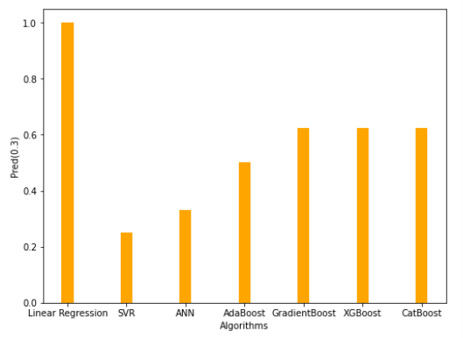
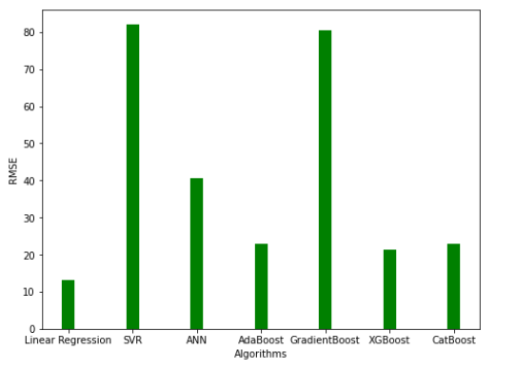
Result Analysis
The following figures shows performance results (Pred(0.3),RMSE)s of UIMS Dataset

Slide 25
Conclusion
After analysing the results of ensemble methods, we discovered that Pred(0.3) and RMSE values are having better results for Gradient Boost compared to other ensemble methods (Adaboost, XGBoost, CatBoost).
Therefore, Gradient Boost provides more accurate prediction of software maintenance out of all the ensemble methods.

Slide 26
References
Kaur, A., Kaur, K., & Malhotra, R. (2010). Soft computing approaches for prediction of software maintenance effort. International Journal of Computer Applications, 1(16), 69-75.
Elish, M. O., Aljamaan, H., & Ahmad, I. (2015). Three empirical studies on predicting software maintainability using ensemble methods. Soft Computing, 19(9), 2511-2524.
Riaz, M., Mendes, E., & Tempero, E. (2009, October). A systematic review of software maintainability prediction and metrics. In 2009 3rd international symposium on empirical software engineering and measurement (pp. 367-377). IEEE.
Aljamaan, H., Elish, M. O., & Ahmad, I. (2013, June). An ensemble of computational intelligence models for software maintenance effort prediction. In International Work-Conference on Artificial Neural Networks (pp. 592-603). Springer, Berlin, Heidelberg.
Baqais, A. A. B., Alshayeb, M., & Baig, Z. A. (2014). Hybrid intelligent model for software maintenance prediction.
Abirami, S., Kousalya, G., Balakrishnan and Karthick, R., 2022. Varied Expression Analysis of Children With ASD Using Multimodal Deep Learning Technique.

Slide 27
References
En.wikipedia.org. 2022. Gradient boosting - Wikipedia. [online] Available at: <https://en.wikipedia.org/wiki/Gradient_boosting> [Accessed 6 May 2022].
Zhang, Tao & Lin, Wuyin & Vogelmann, Andrew & Zhang, Minghua & Xie, Shaocheng & Qin, Yi & Golaz, Jean‐Christophe. (2021). Improving Convection Trigger Functions in Deep Convective Parameterization Schemes Using Machine Learning. Journal of Advances in Modeling Earth Systems. 13. 10.1029/2020MS002365.
Abirami, S., Kousalya, G., Balakrishnan and Karthick, R., 2022. Varied Expression Analysis of Children With ASD Using Multimodal Deep Learning Technique.
Blog.thinknewfound.com. 2022. [online] Available at: <https://blog.thinknewfound.com/2020/05/defensive-equity-with-machine-learning/xg-boost-final-01/> [Accessed 6 May 2022].
Medium. 2022. CatBoost regression in 6 minutes. [online] Available at: <https://towardsdatascience.com/catboost-regression-in-6-minutes-3487f3e5b329> [Accessed 6 May 2022].
Analytics Vidhya. 2022. CatBoost | Predict Mental Fatigue Score using CatBoost. [online] Available at: <https://www.analyticsvidhya.com/blog/2021/04/how-to-use-catboost-for-mental-fatigue-score-prediction/> [Accessed 6 May 2022].

Slide 28
THANK YOU!

